Slide 1
ECEN 5283 Project 2: Camera Calibration
Alexander Rose
Oklahoma State University
3/2/2024

Slide 2
Objective
For this project, two retina images were provided and edge detection methods were implemented to find the blood vessels on the images.
A comparison of edge detection methods between Canny, Laplace of Gaussian (LoG), and Matched filtering with length filtering (LF) is shown.
A variety of parameters must be tested to find the best edge detection results

Slide 3
Technical Background
Edge detection is important for finding features and borders in images
These can range from the retina blood vessels in this project, to animals or other objects
The noise effect of an image must be reduced with pre-filtering
Canny (1986) established critical criteria in selecting an edge detection filter:
Signal to Noise Ratio must be high, that is, stronger response to edge than noise
Edge Localization: The filter response should be strong at x = 0 and not elsewhere
Low False Positives: There must only be one maximum within the neighborhood
From these criteria, three prominent edge detection filters emerged
Canny, LoG, and Matched Filtering

Slide 4
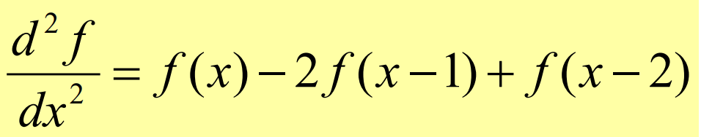
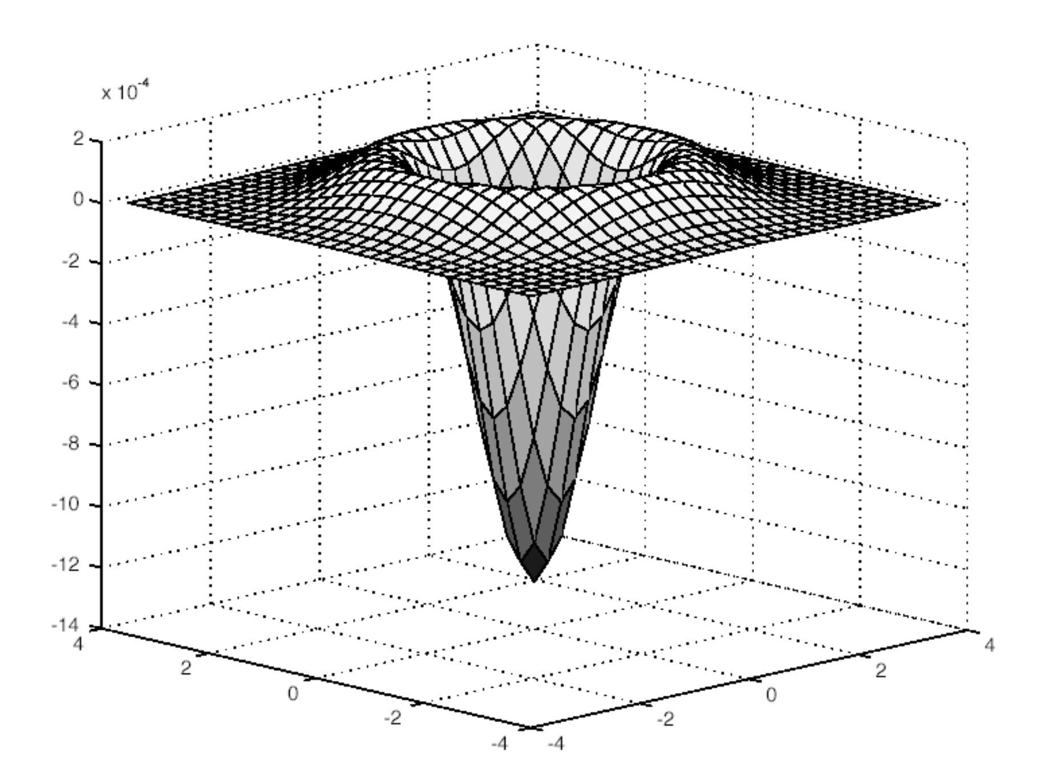
Technical Background
The Laplace of Gaussian (LoG) is a Laplace function with a Gaussian pre-filter, shown below.
The Canny method utilizes the gradient of two first order derivatives corresponding to the rows and columns of an image.
Compute the first order derivatives of the rows and columns
Compute the magnitude and direction of the gradient
Apply non-maximum suppression to the gradient magnitude, finding maximum along the gradient direction
Weak edges can be linked after implementing a connectivity analysis.

Slide 5
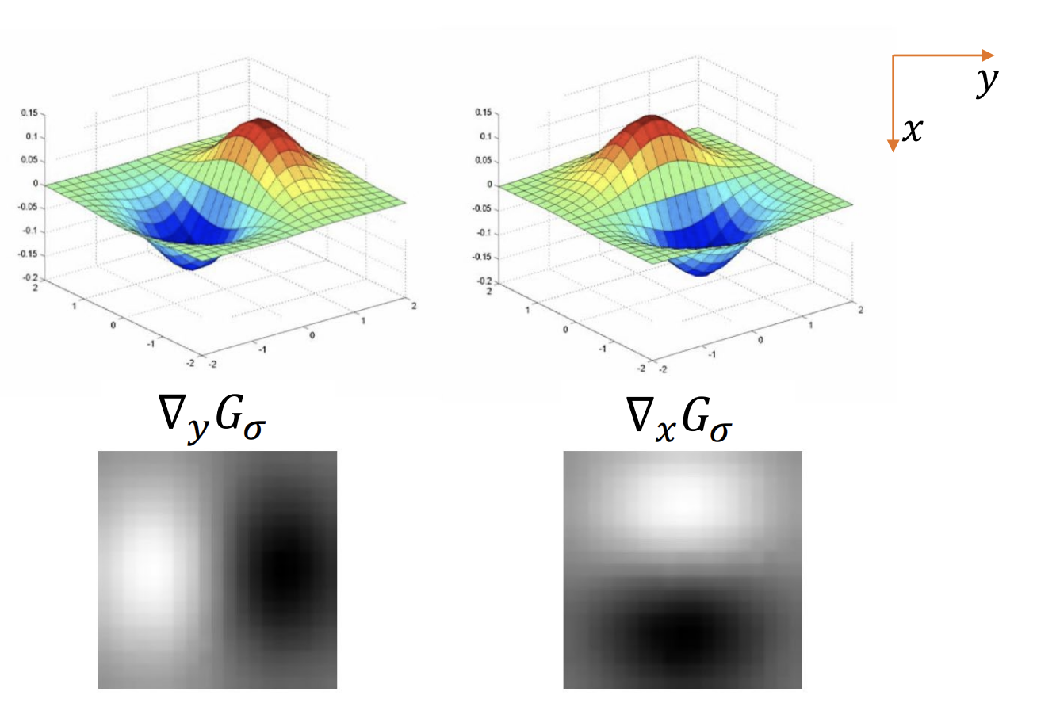
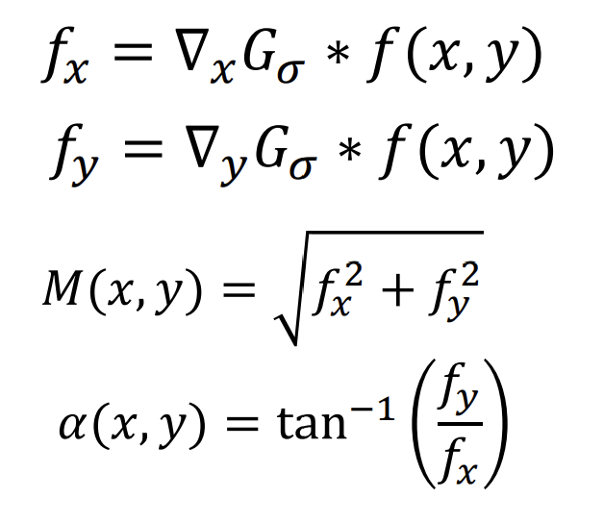
Technical Background – Canny continued
Relevant equations
Canny Gradient
M(x,y) and α(x,y) represent the magnitude and direction of the gradient respectively.

Slide 6
Technical Background – Matched Filter
The matched filter implements a gaussian filter along one direction, rotating it, then applying the rotated filter. This is repeated until a bank of filtered images is completed.
The filtered image bank is then checked pixel by pixel to find the strongest response to filtering with a new image formed from these responses.
After a threshold is chosen, pixel gray values below the threshold are set to 0 (black) and above are set to 1 (white).
Lastly, to eliminate small, weak edges which are disconnected from stronger edges, a length filtering technique is applied to the image. This involves labeling each cluster of connected pixels with value = 1, then removing the clusters below a certain threshold.

Slide 7
Experimental Results

Slide 8
General process
I first experimented with Retina 1 to get a feel for how the different parameters affected the image quality after filtering. In particular, I varied sigma, the filter size, and the number of filters.
The filter is the gaussian function in matrix form with the size determinine the rows/columns of the nxn matrix.
The number of filters, as implied, changes the number of filters used on the image. I set the rotation angle between each filter to be equal to 180°/(number of filters). That is, if number of filters is 10, then there is an 18° difference between each filter with the first filter at 0°, then 10°and stopping at 162°.
After finding optimal matched filtering parameters, I experimented with the length filtering to determine how many pixels to remove for a good image.

Slide 9
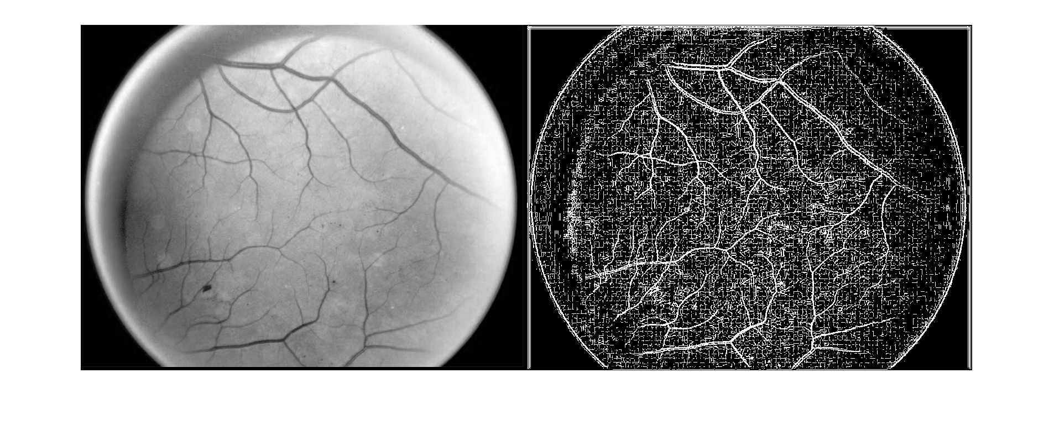
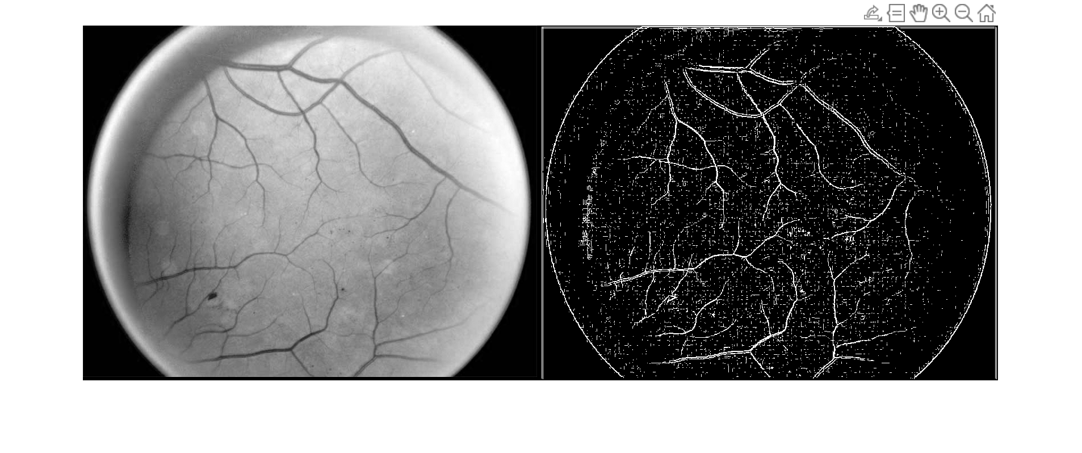
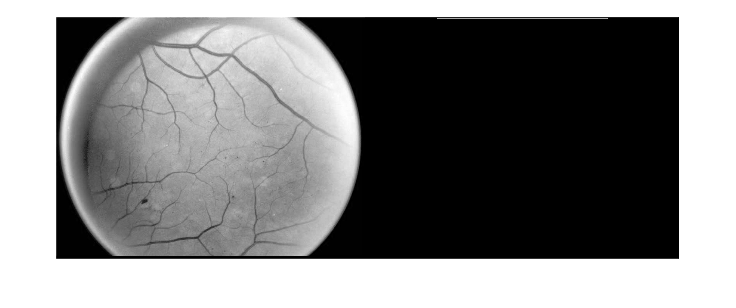
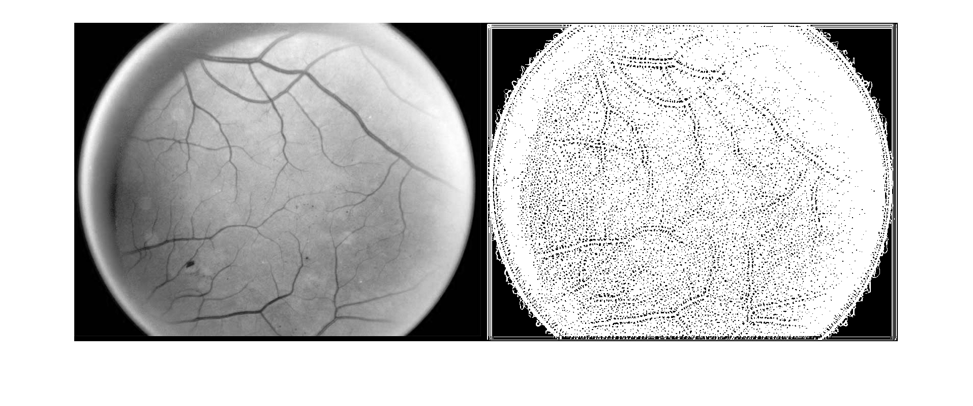
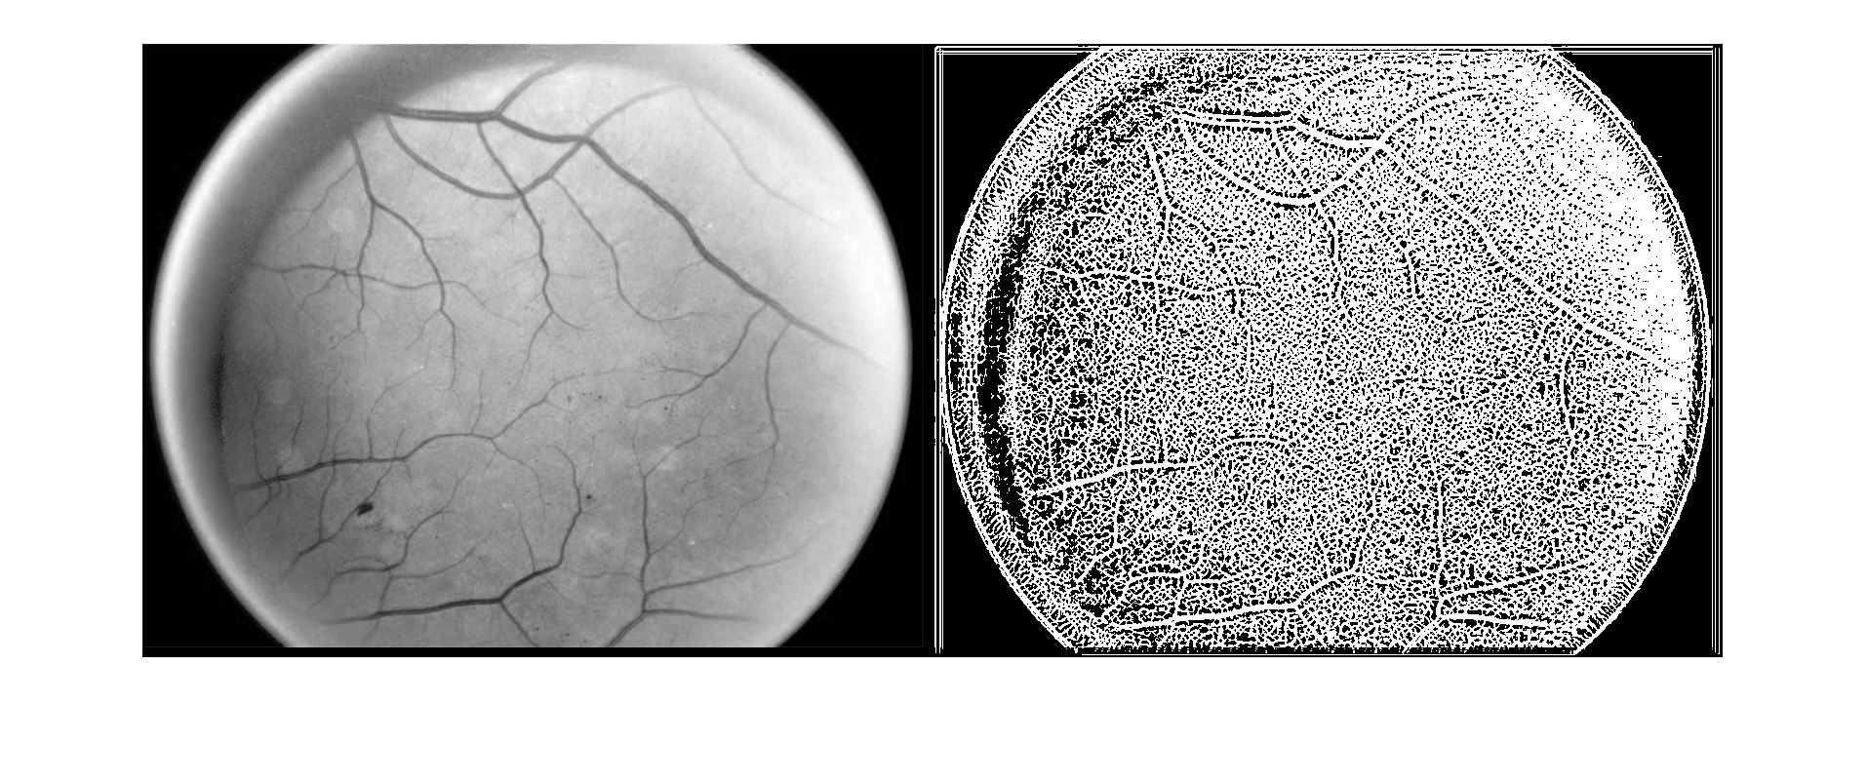
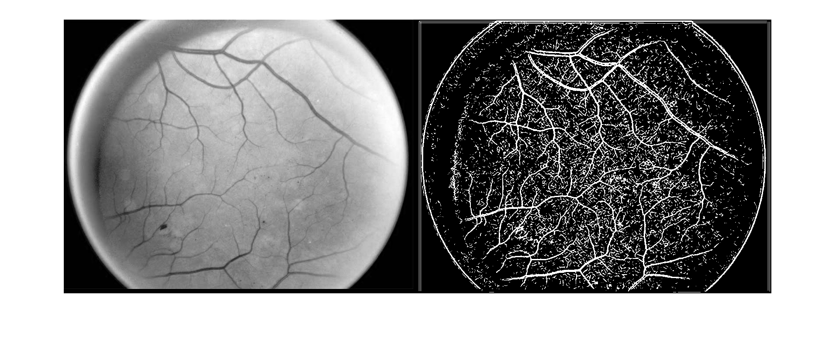
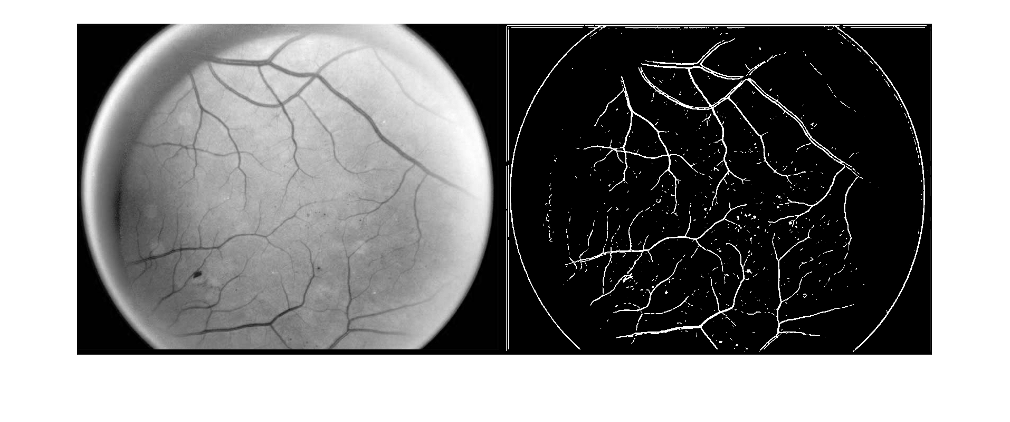

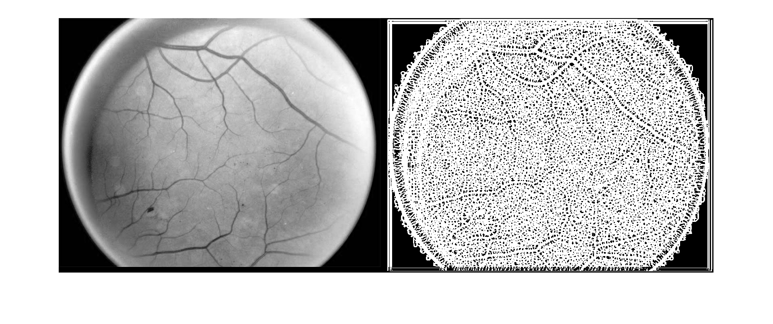
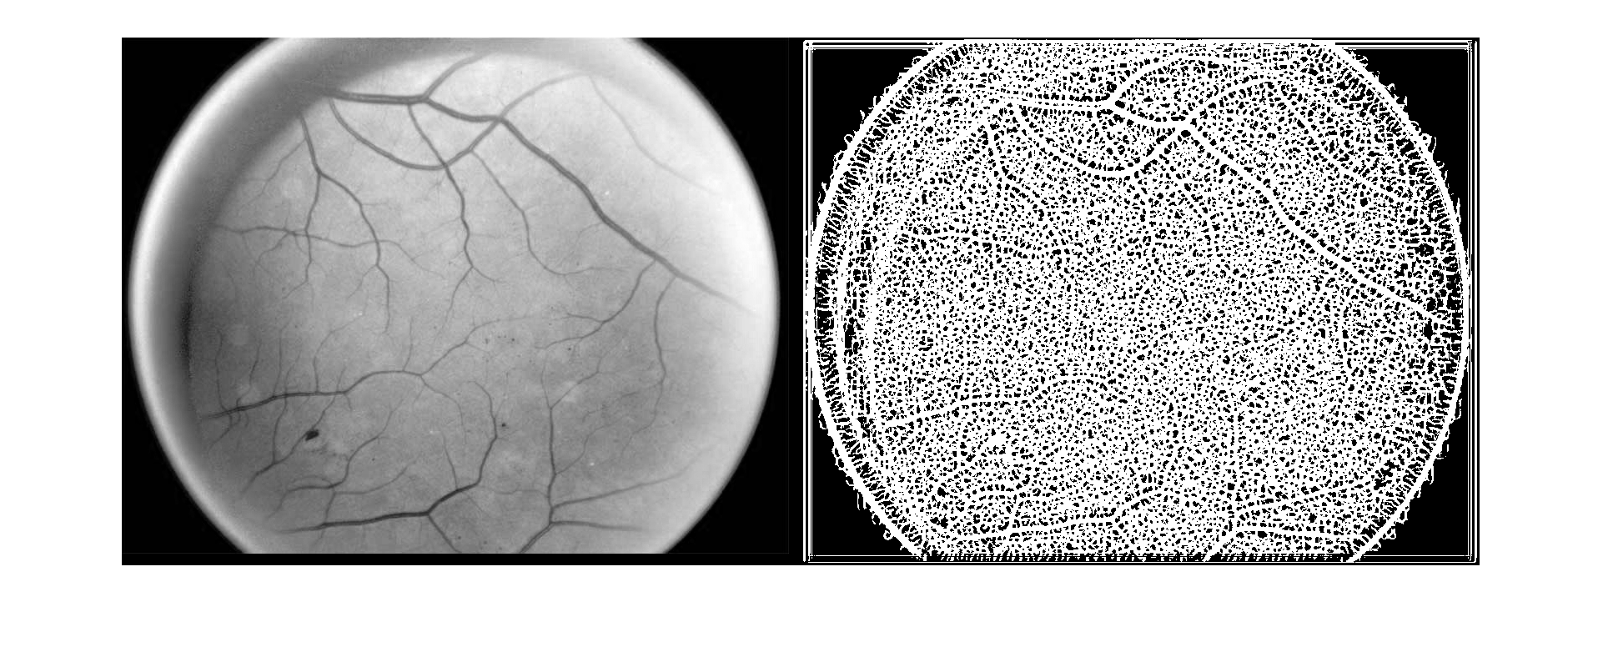
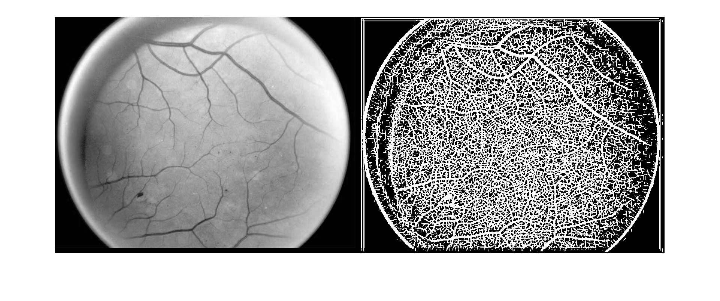
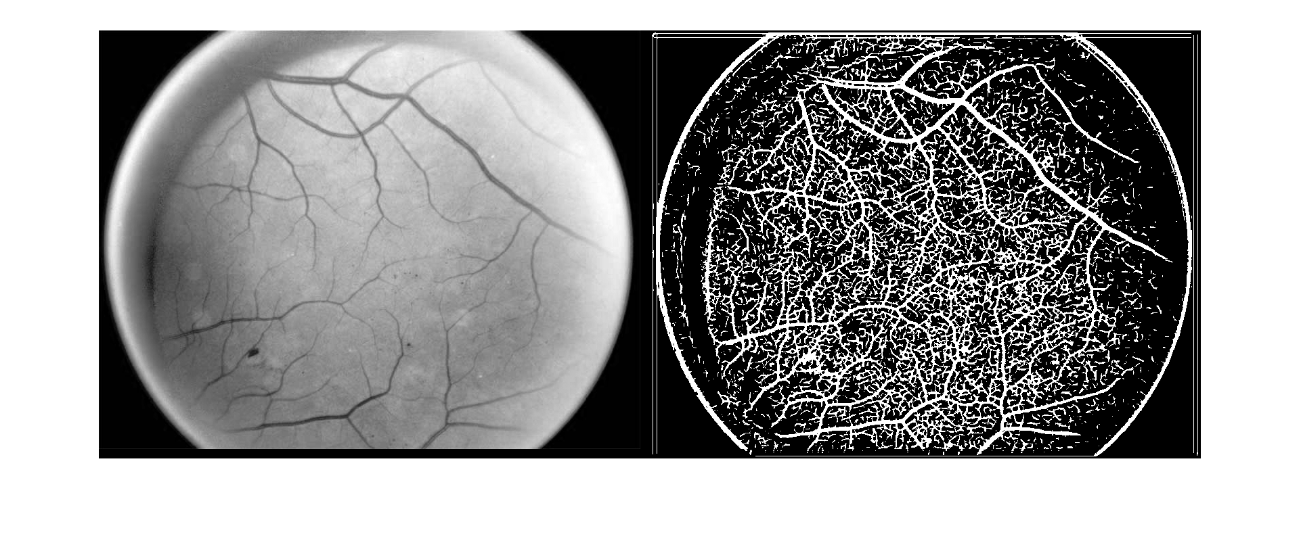
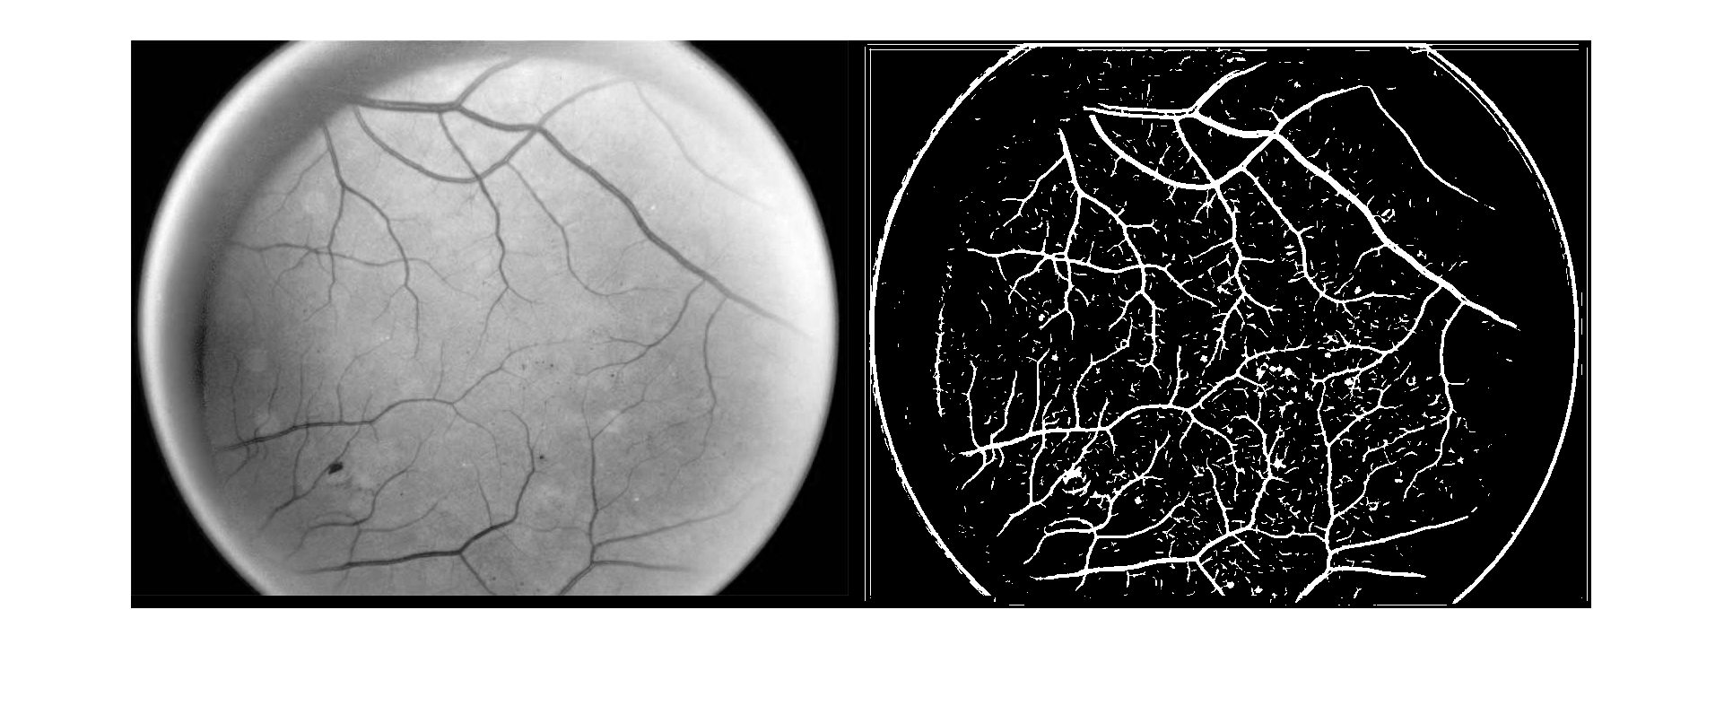
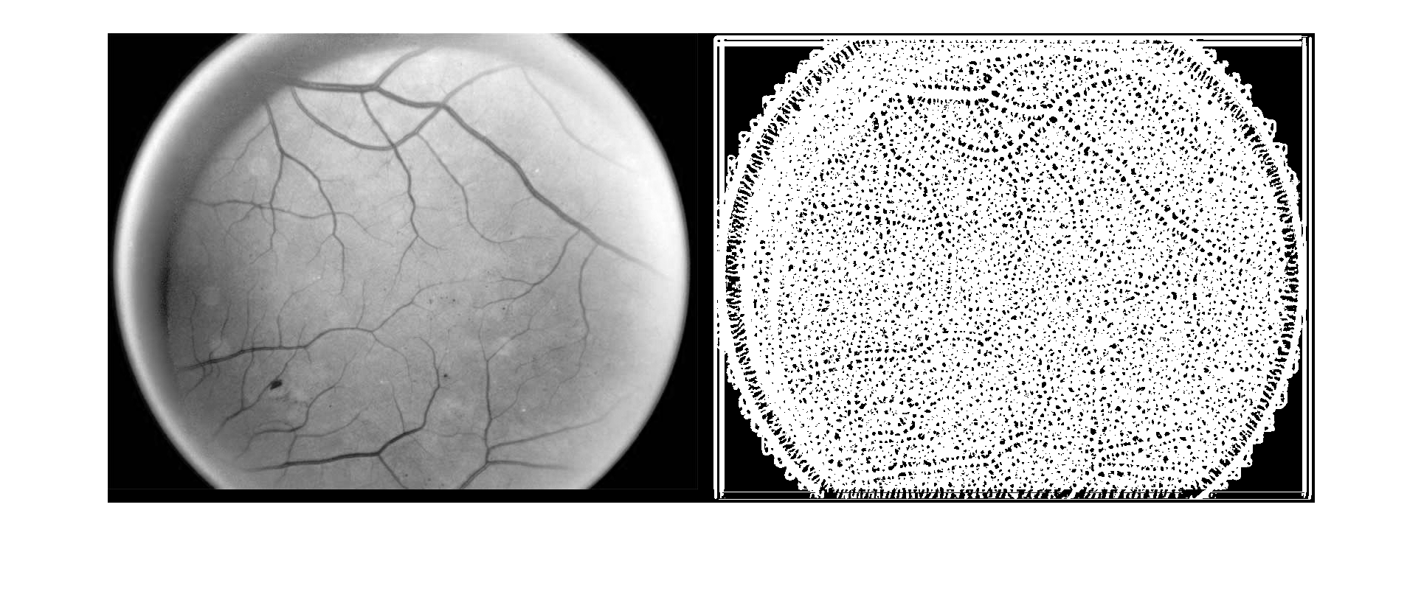
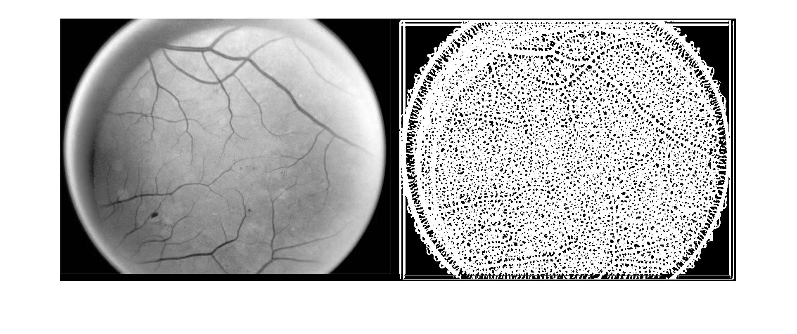
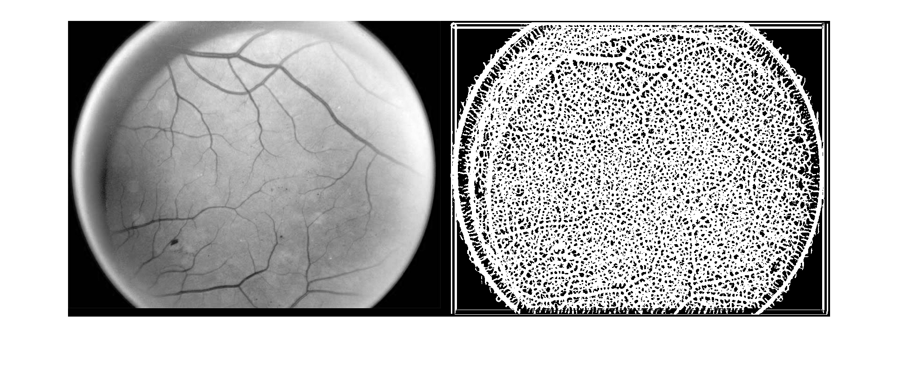
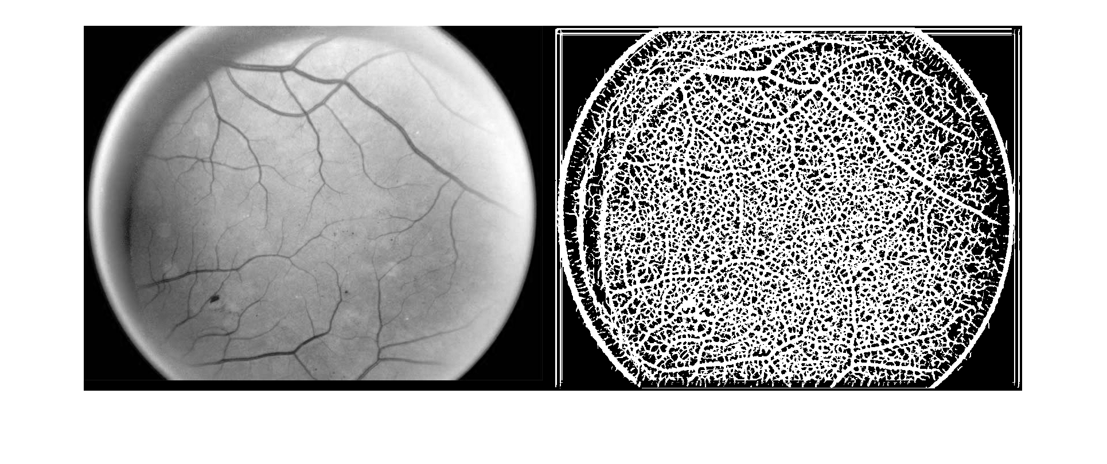
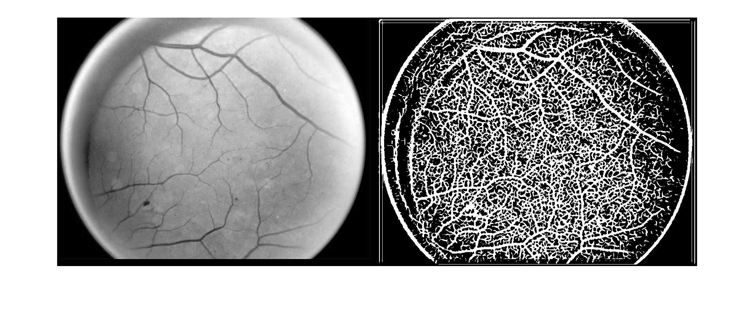
Filter Size
9 7 5 3
Sigma
1 2 3 4 5

Slide 10
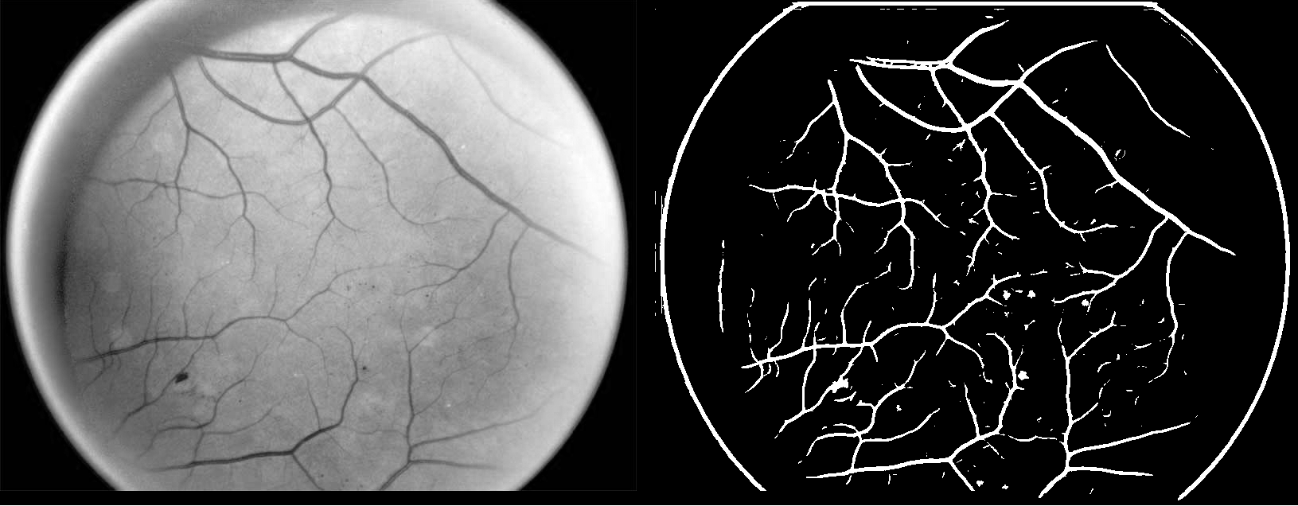
Observations
Sigma should roughly equal to the filter size but both should be relatively large
This is likely since sigma translates to the intensity of the gaussian function; when the sigma is large and the filter small, only very prominent features over a small distance are detected. If a feature is not prominent enough over a short distance, it isn’t detected (see sigma 3, 4, 5 for filter size 3).
For this same reason if sigma is small with a large filter size, small features and noise over a large area are detected when they should not be. This is why some images appear almost completely white.
After tweaking more, I chose a sigma of 8, filter size of 9, shown on the right.

Slide 11
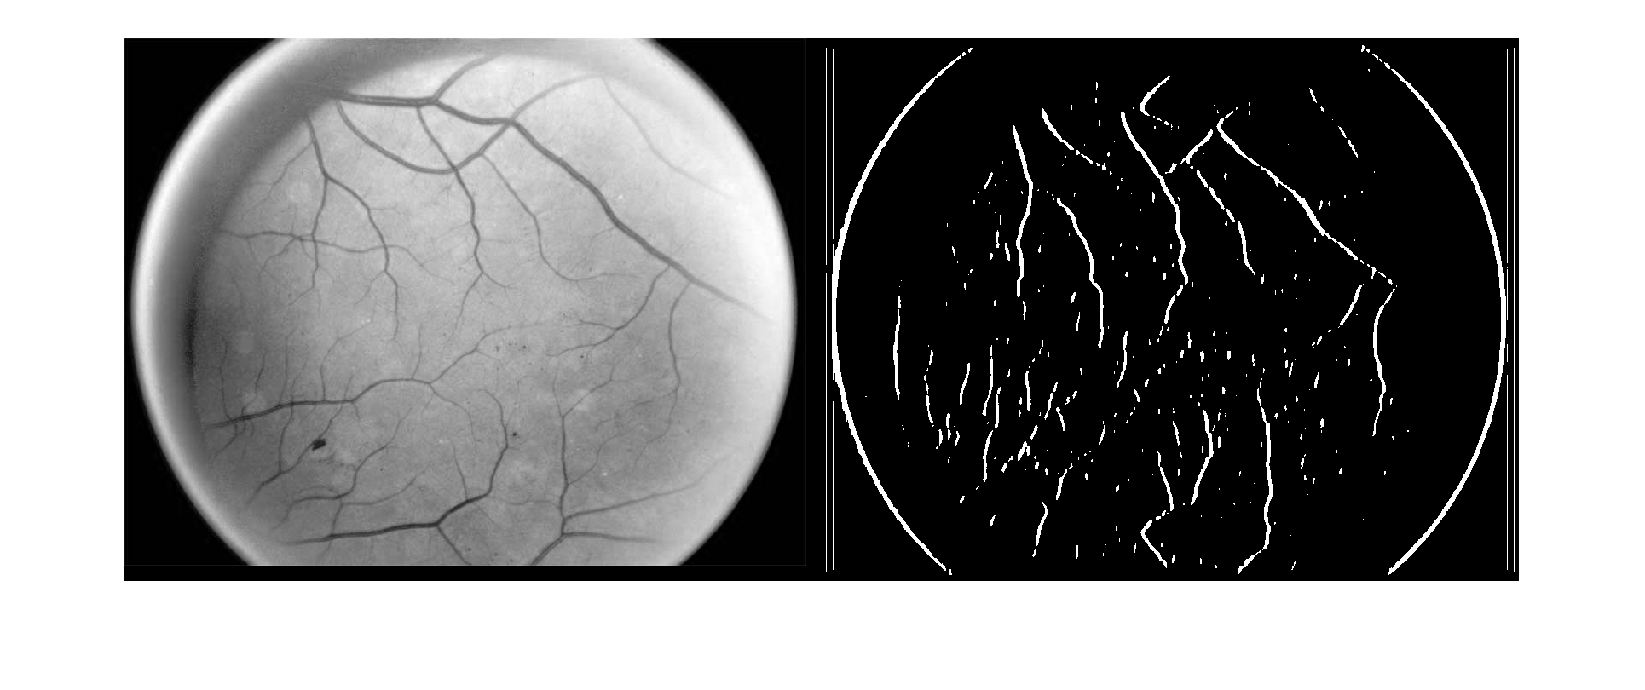
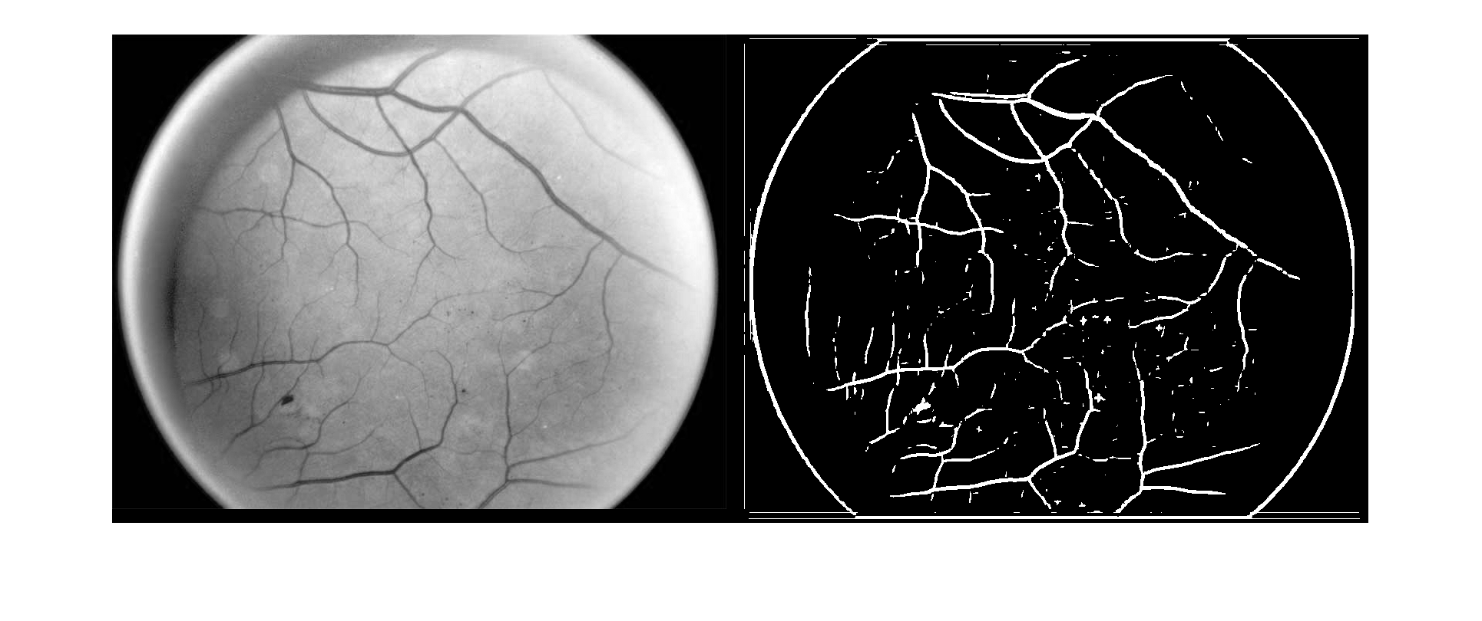
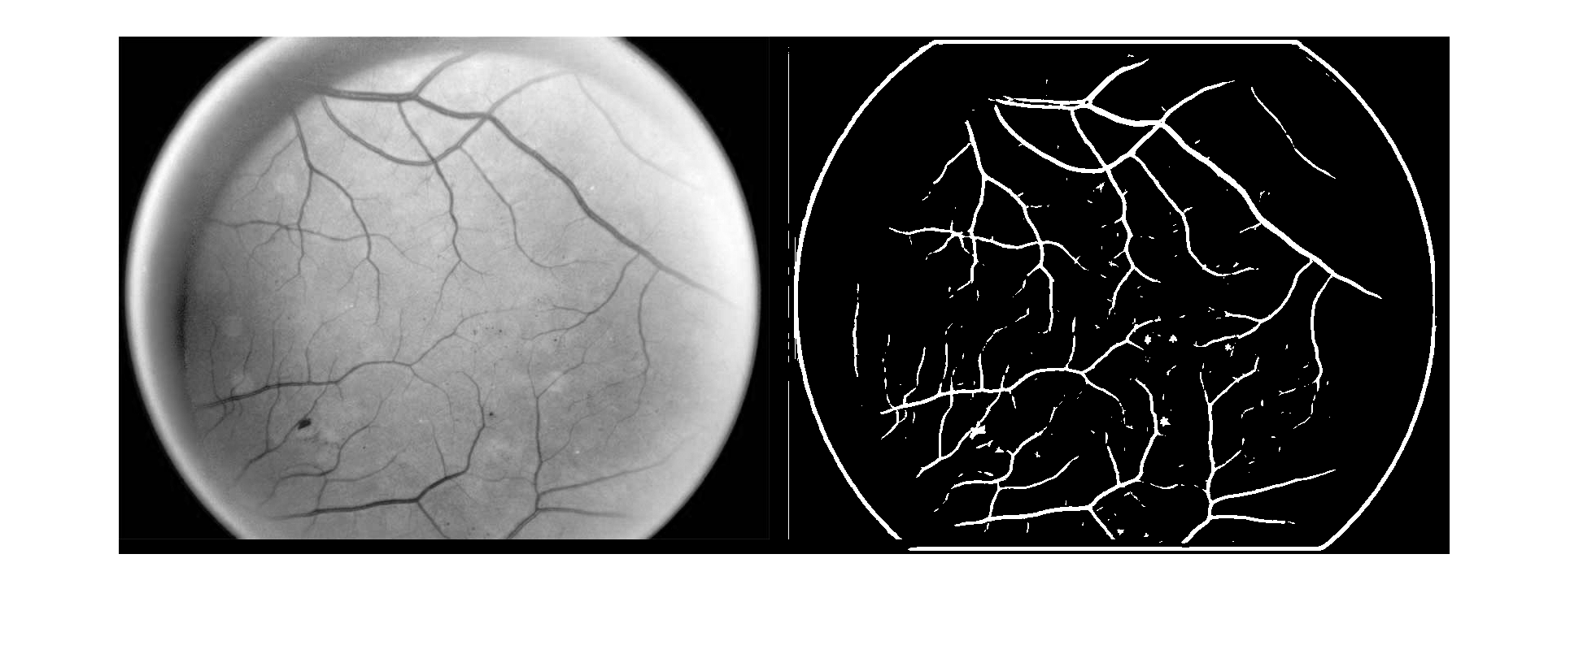
Altering Number of Filters
Another observation is that the number of filters doesn’t need to be very large to get a good image.
Shown on the right is a comparison of the retina for sigma = 8, filter size = 9 and a varying filter number.
Top Left: Retina
Top Right: filter number = 1
Bottom Left: filter number = 2
Bottom Right: filter number = 3
As a reminder, the angle between filters will be 180°/(filter number) with the first filter at 0°

Slide 12
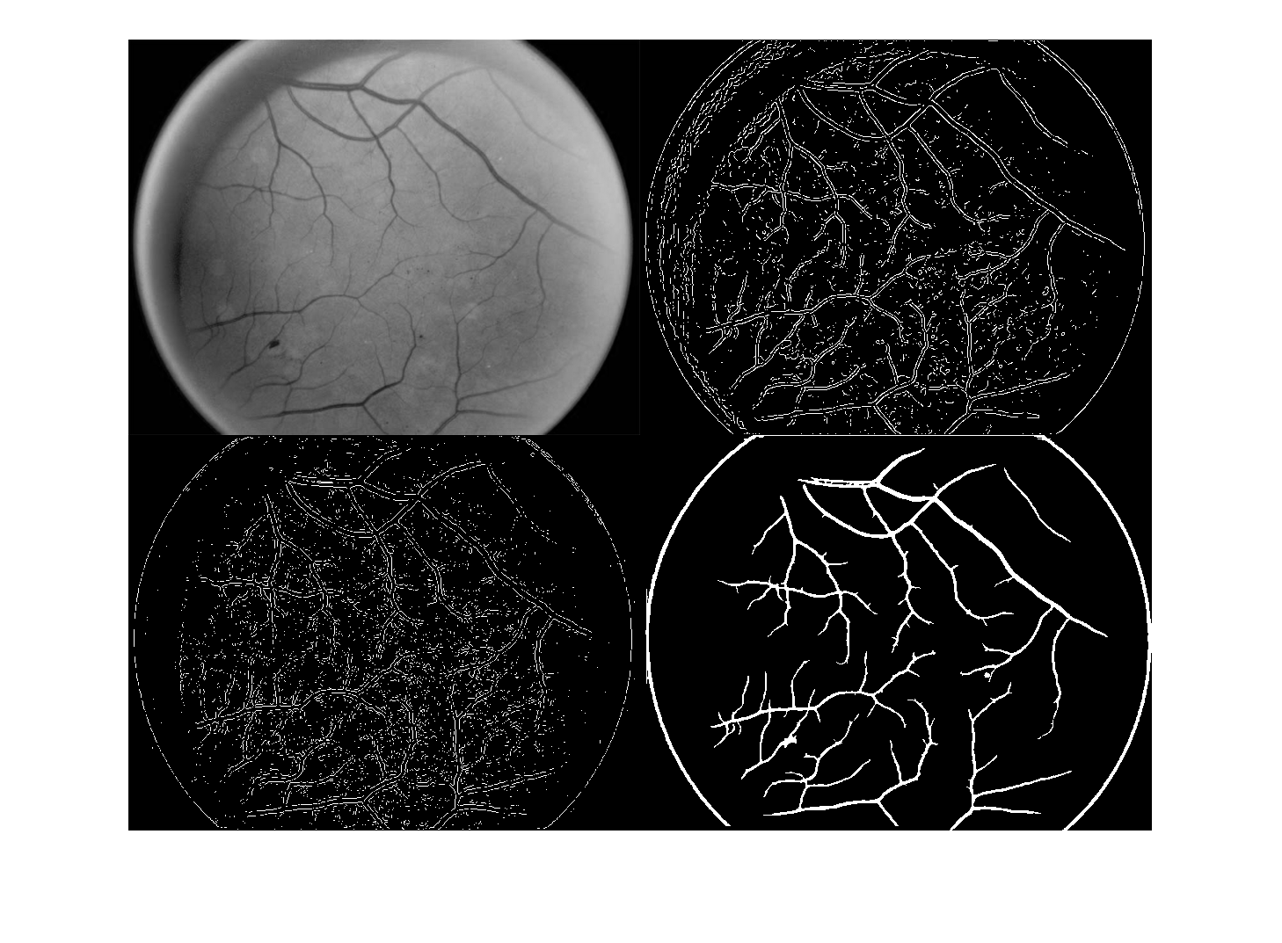
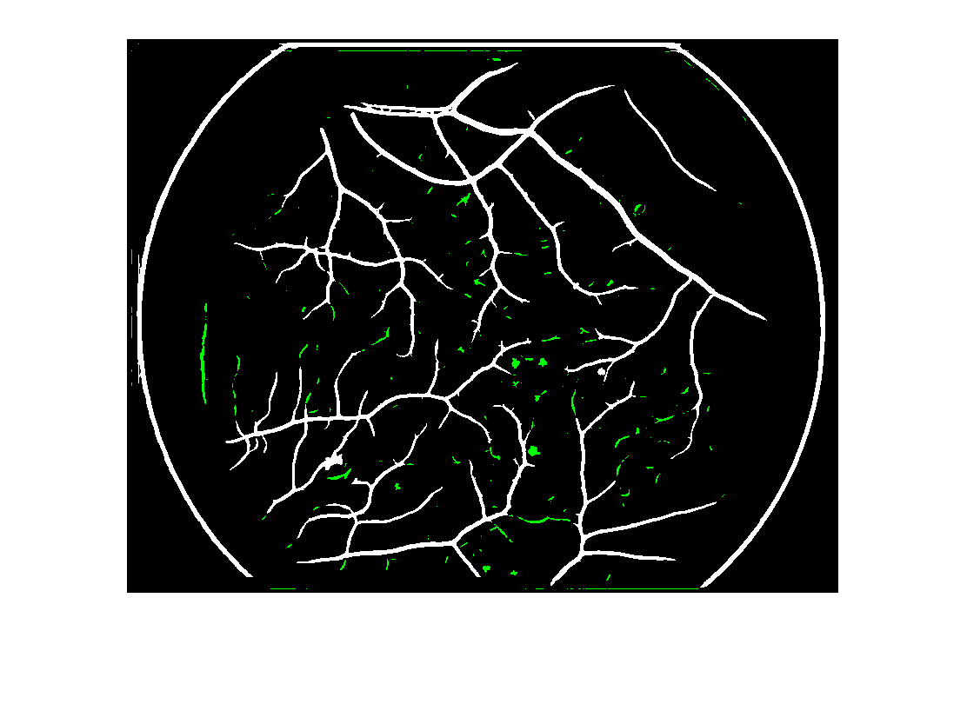
Length Filtering Retina 1
I determined that a filter with sigma = 8, filter size = 9 (i.e. 9x9 matrix), and filter number = 10 was a good balance of the parameters.
For length filtering, I turned up the cluster size to be filtered out until all edges too small and all edges that aren’t veins were eliminated. Shown below, the green pixels indicate edges that were eliminated.
The any clusters below a size of 300 pixels were eliminated only to eliminate the green edge circled in red (this isn’t a vein). Otherwise, a size of 120 is sufficient.

Slide 13
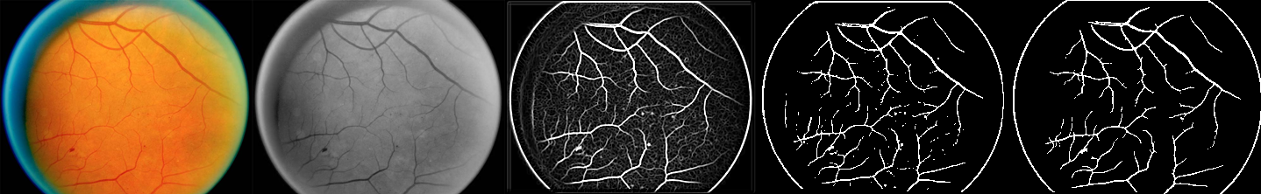

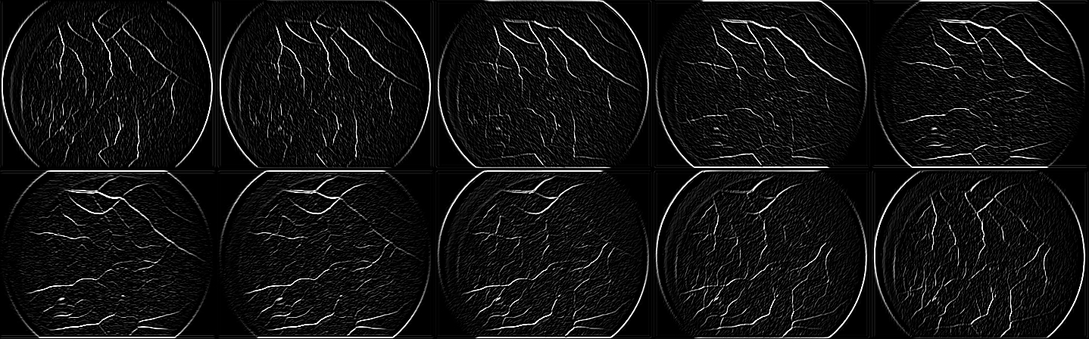
Retina 1 Final Results
Above: The Retina at each stage: Original, Green Channel only, image fusion, thresholding, and length filtering
Below: Bank of filter kernels used
Below: Images after filtering

Slide 14
Retina 1 Final Results
Top Left: Retina;
Top Right: Canny;
Bottom Left: LoG;
Bottom Right: Matched Filter

Slide 15
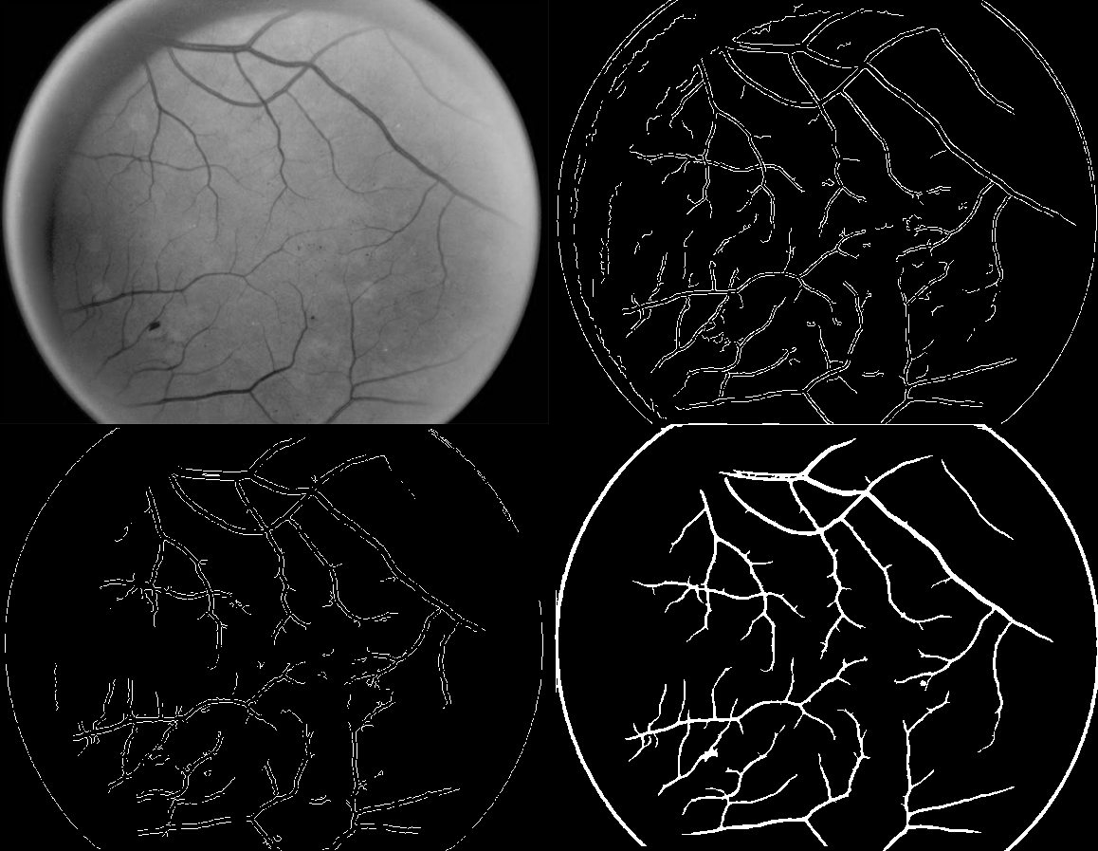
Retina 1 Final Results
The same images after
length filtering (LF) applied to
Canny and LoG.

Slide 16
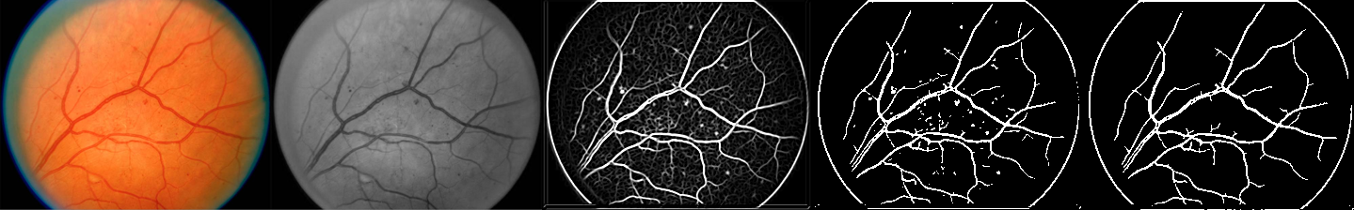
Retina 2 Final Results
With the insights gained from testing retina under various parameter values, I optimized for retina 2. Unlike with retina 1, the following slides contain the final result rather than the full process.
Below: The Retina at each stage: Original, Green Channel only, image fusion, thresholding, and length filtering

Slide 17

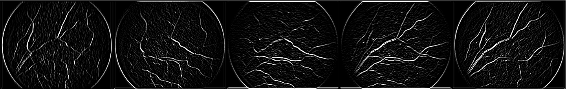
Retina 2 Final Results
Above: Filter bank; Below: Filtered images

Slide 18
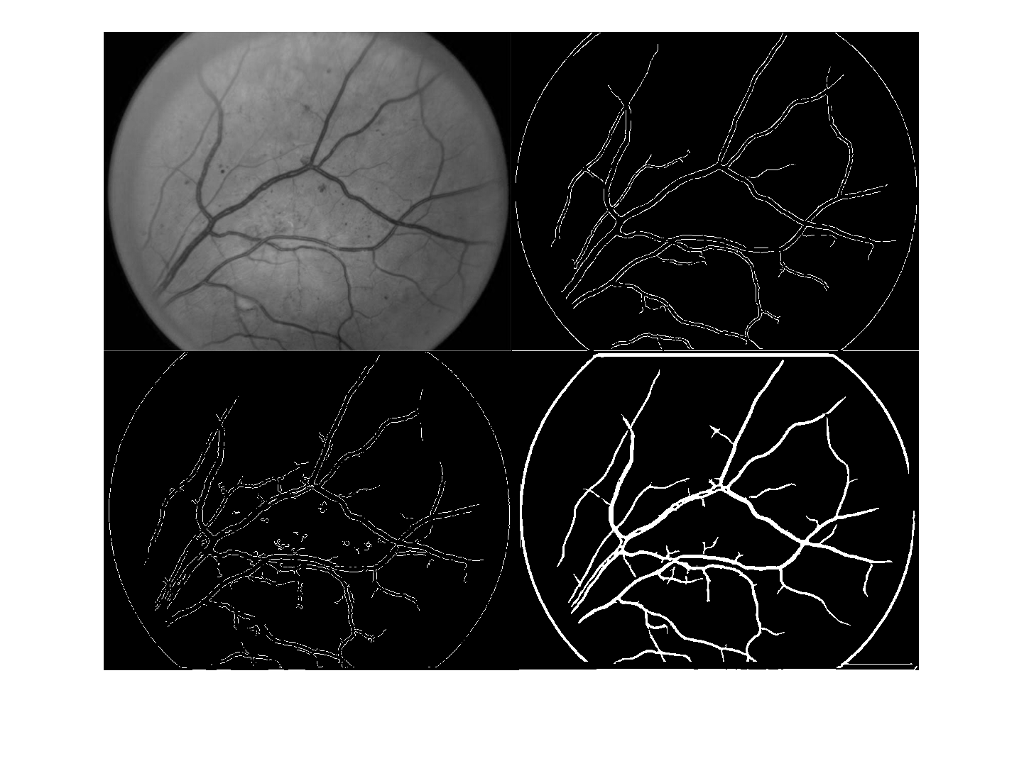
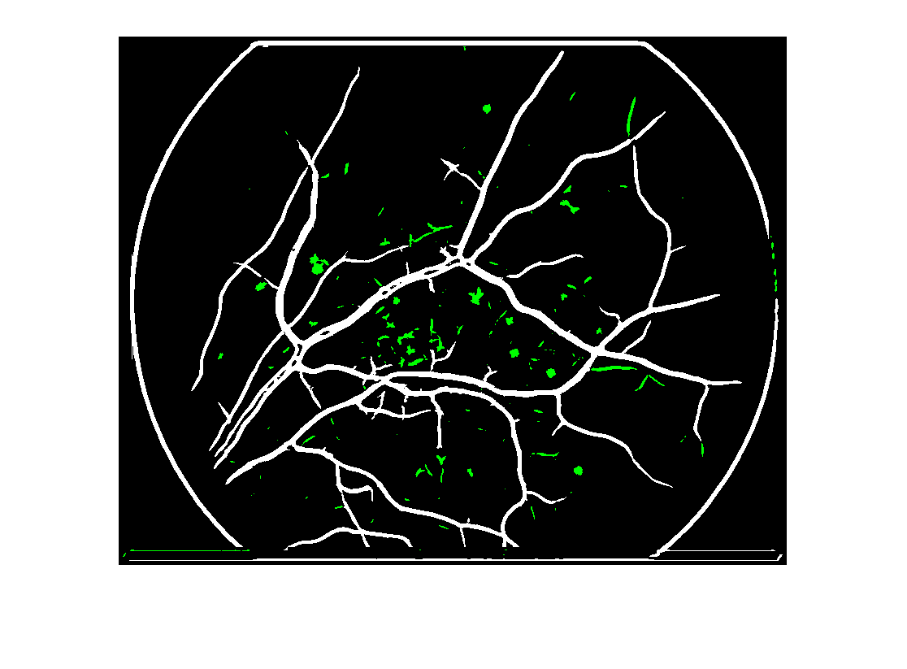
Retina 2 Technique Comparison
Top left: Original; Top Right: Canny with LF
Bottom Left: LoG with LF; Bottom Right: Matched Filtering with LF
Retina 2 after length filtering

Slide 19
Final Parameter Values
Retina 1
Retina 2
Matched Filter
σ = 8
Filter size = 9
# of filters = 10
LF = 300
Canny
LF = 25
LoG
LF = 25
Matched Filter
σ = 11
Filter size = 11
# of filters = 5
LF = 300
Canny
LF = 90
LoG
LF = 25

Slide 20
Discussion and Conclusion
The matched filtering looks better to me than the Canny and the LoG, but maybe I’m biased because I made it and I’m proud of it.
I tried to optimize the threshold of the Canny filtering on both retina 1 and retina 2, but it only helped a little. Length filtering was more effective than manually changing the thresholding.

Slide 21
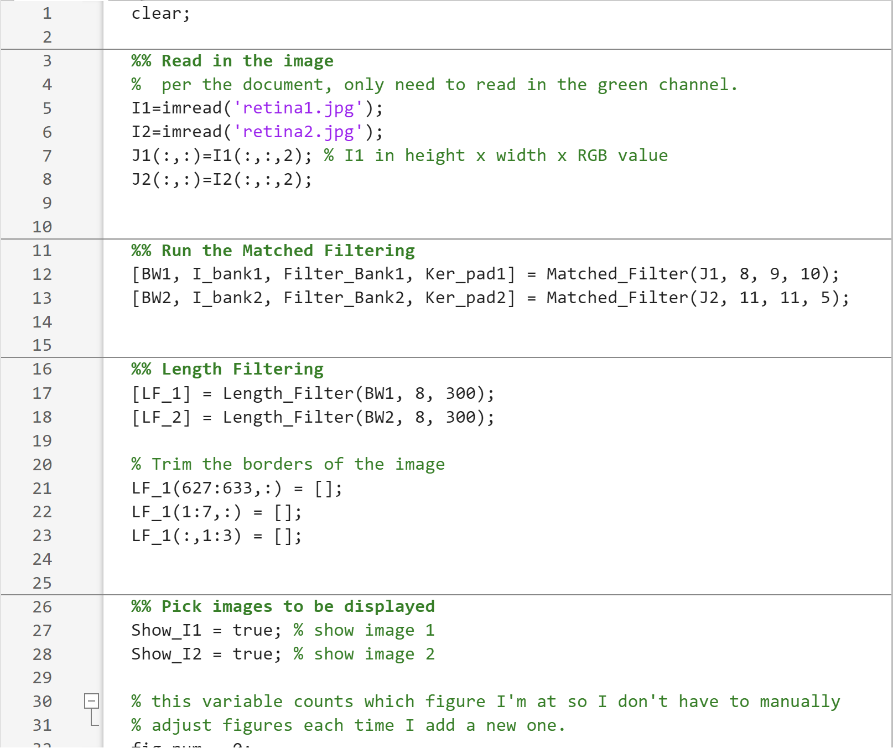
Appendix – Code – Main file

Slide 22
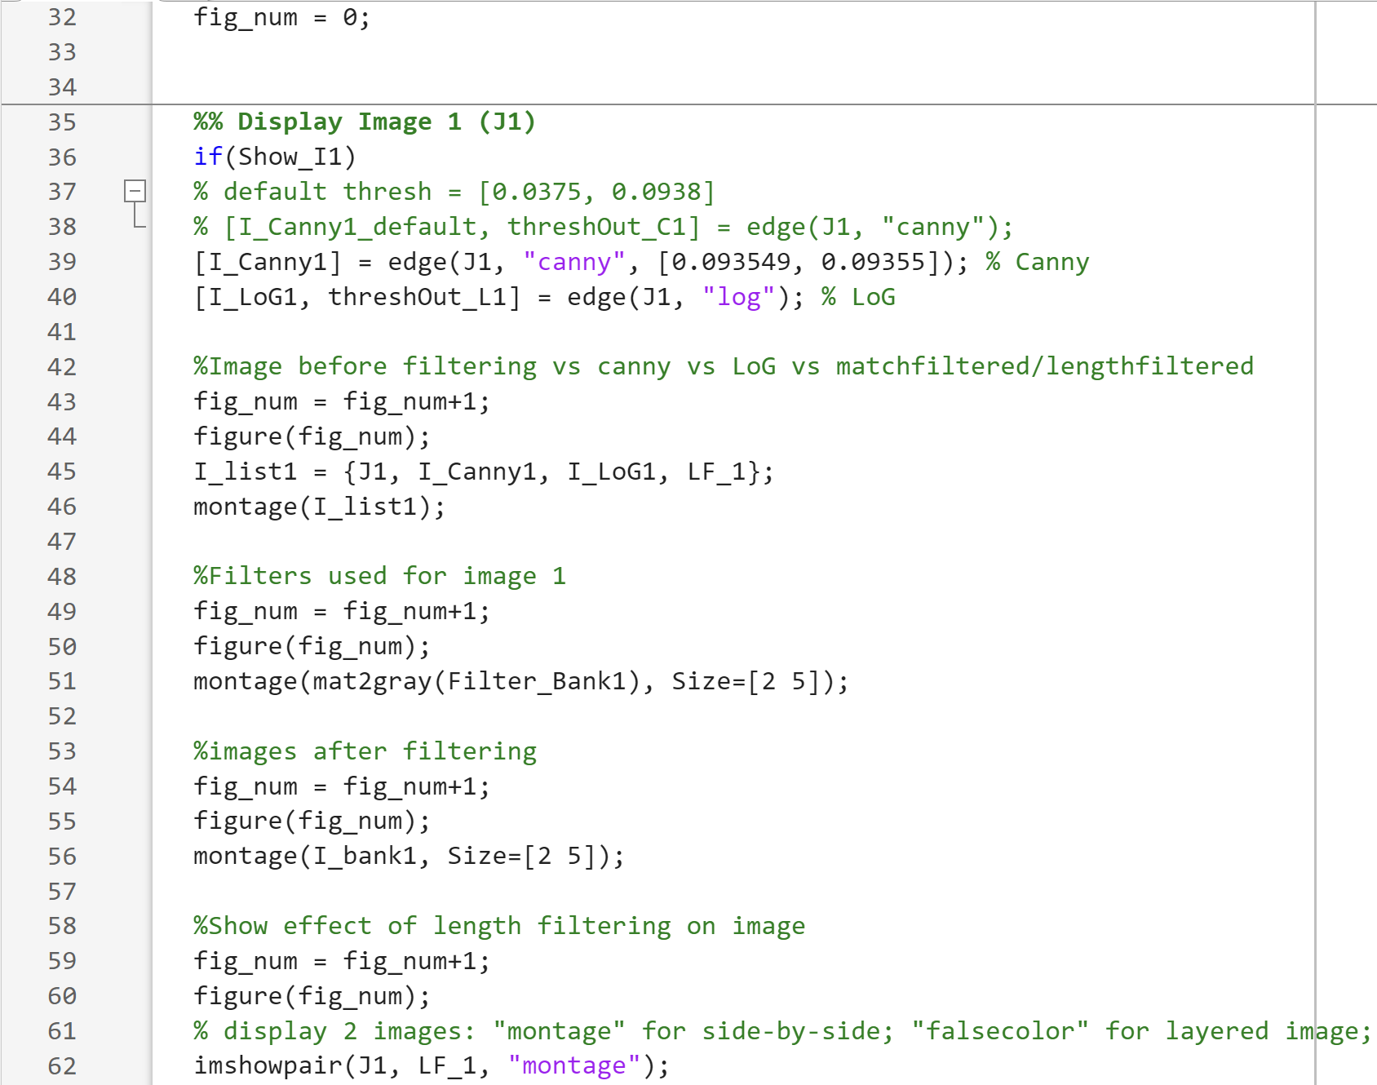
Appendix – Code – Main file

Slide 23
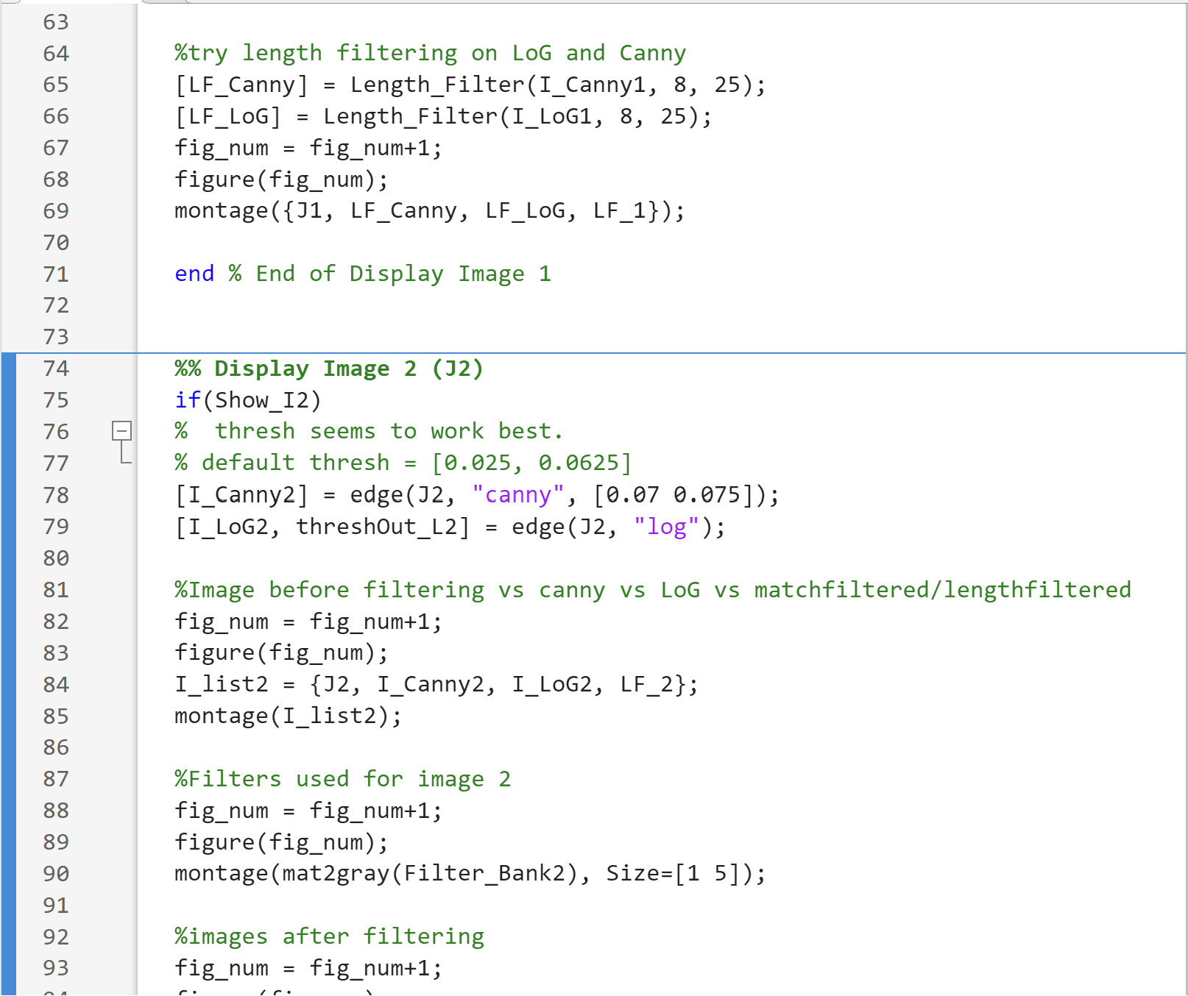
Appendix – Code – Main file

Slide 24
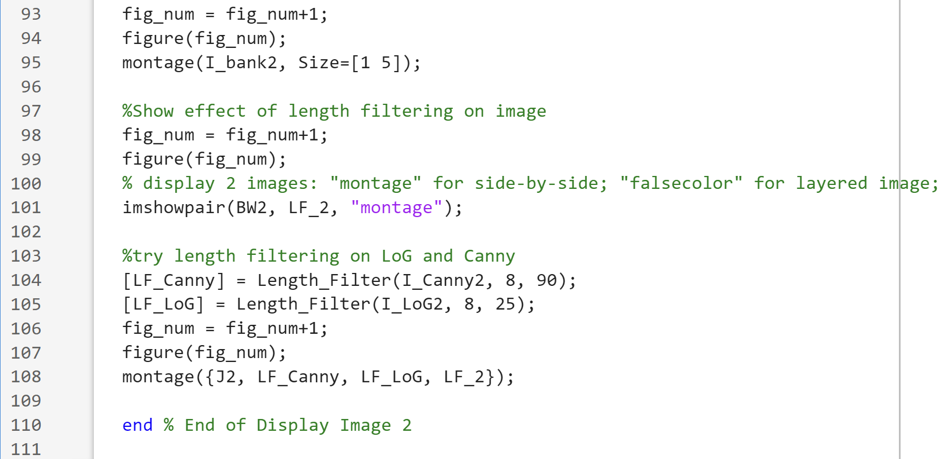
Appendix – Code – Main file

Slide 25
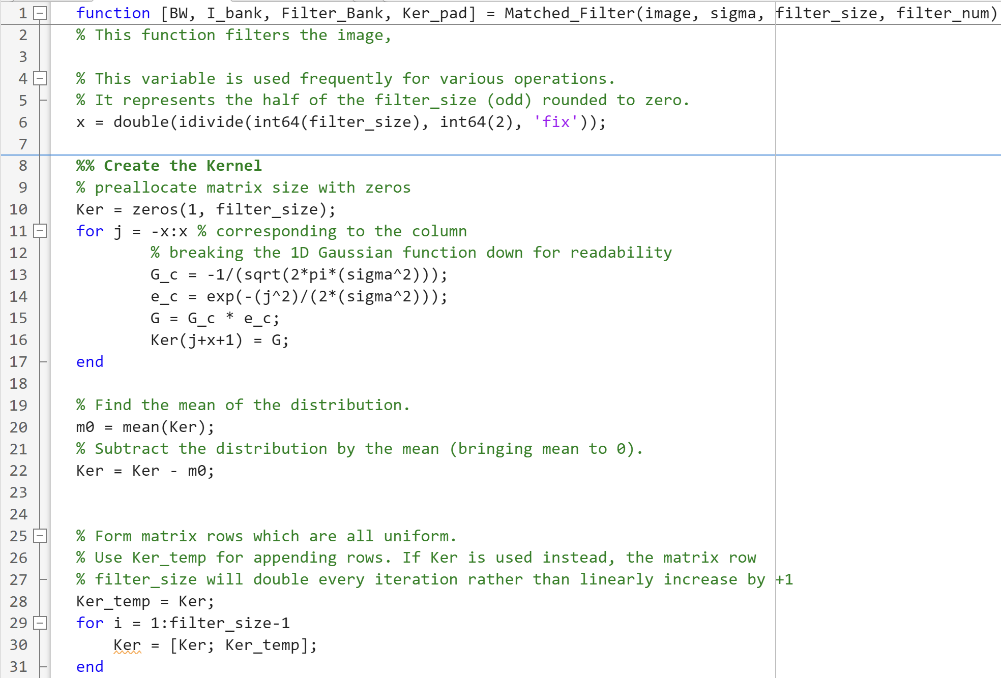
Appendix – Code – Matched Filter

Slide 26
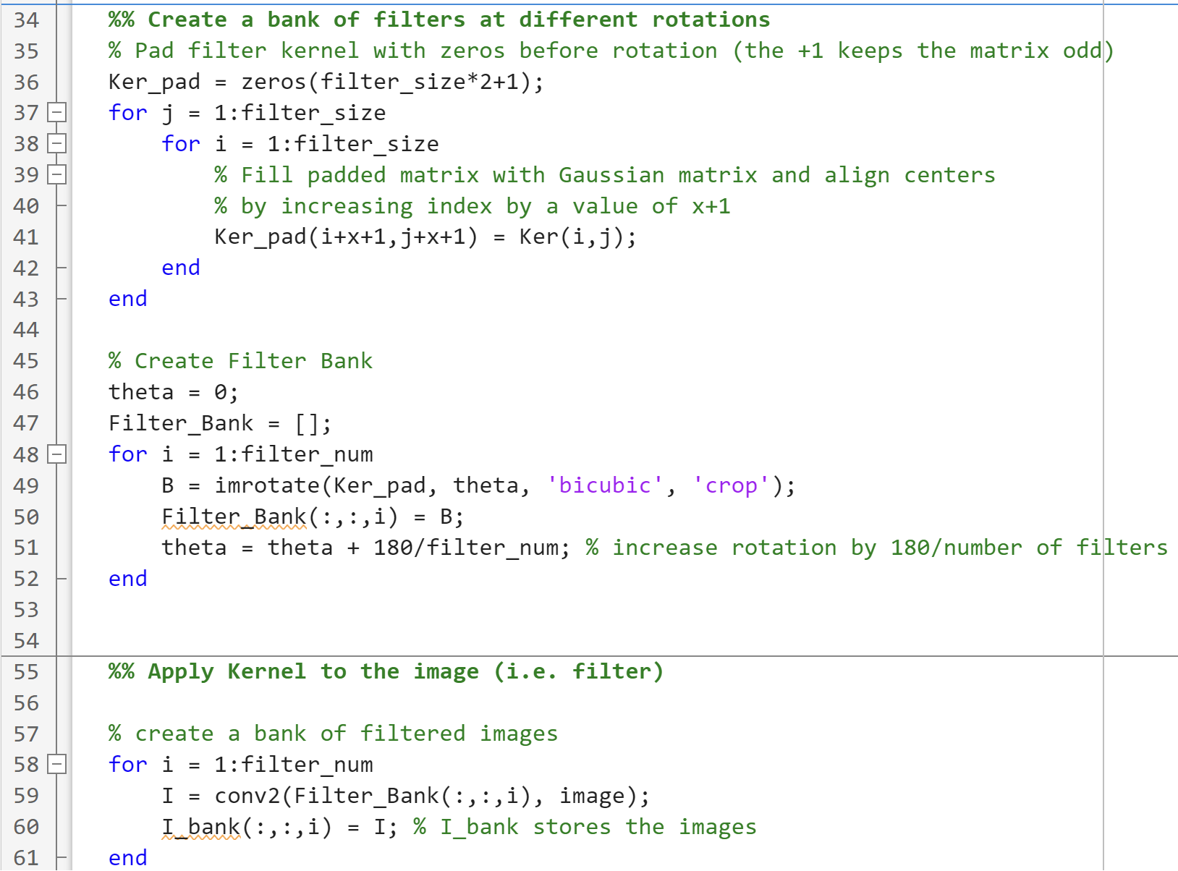
Appendix – Code – Matched Filter

Slide 27
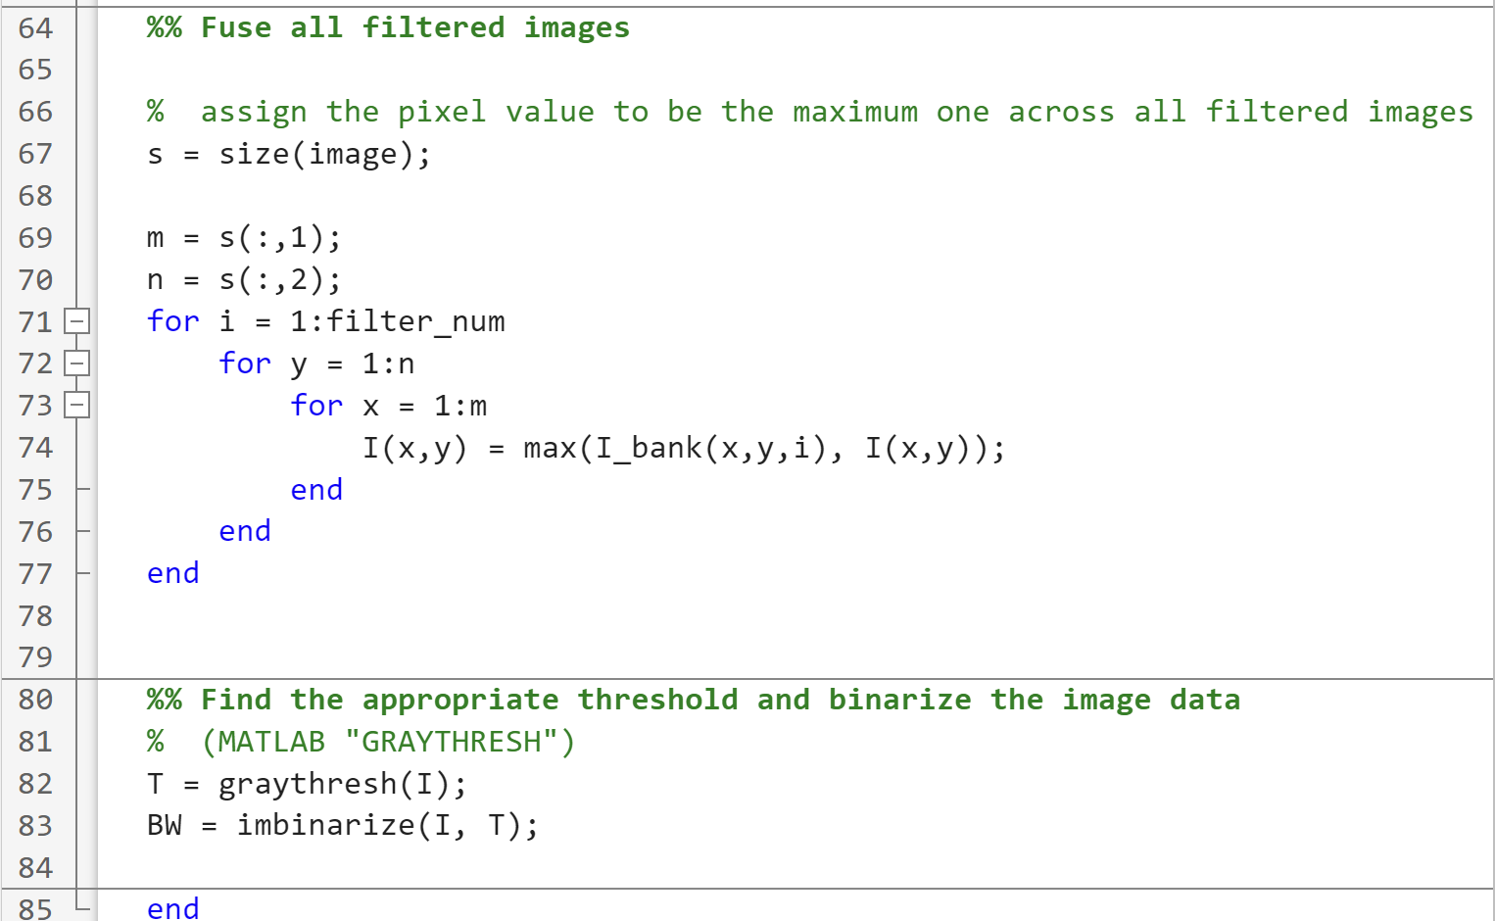
Appendix – Code – Matched Filter

Slide 28
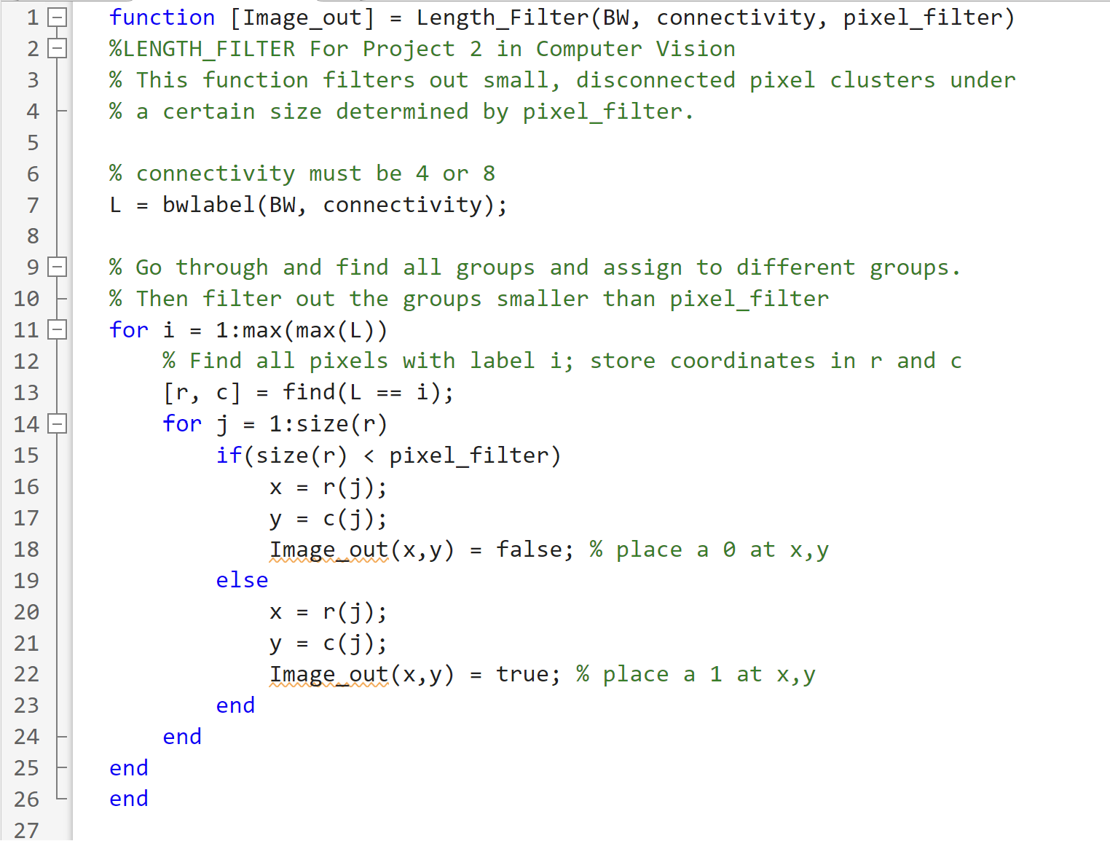
Appendix – Code – Length Filtering

